Slide 1

Filters in image processing Project
Mohamed Hesham

Slide 2
Filters in image processing
The goal of using filters is to modify or enhance image properties and/or to extract valuable information from the pictures such as edges, corners, and blobs

Slide 3
Image enhancement
Enhancing an image provides better contrast and a more detailed image as compare to non enhanced image. Image enhancement has very applications. It is used to enhance medical images, images captured in remote sensing, images from satellite

Slide 4
How
Image enhancement can be done through gray level transformations .

Slide 5
Gray level transformation
There are three basic gray level transformation.
Linear
Logarithmic
Power – law

Slide 6
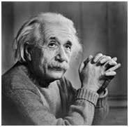
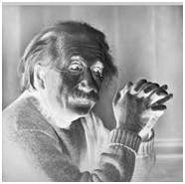
Linear ex :Negative transformation
Negative transformation
negative transformation, which is invert of identity transformation. In negative transformation, each value of the input image is subtracted from the L-1 and mapped onto the output image.

Slide 7
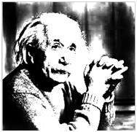
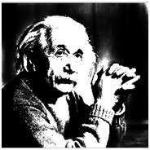
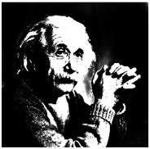
Power – Law transformations
This type of transformation is used for enhancing images for different type of display devices.

Slide 8
image segmentation
Thresholding is a type of image segmentation, where we change the pixels of an image to make the image easier to analyze. we convert an image from color or grayscale into a binary image.
we use thresholding as a way to select areas of interest of an image, while ignoring the parts we are not concerned with

Slide 9
Two main types of filters cont…
Linear filtering is the filtering method in which the value of output pixel is linear combinations of the neighbouring input pixels.

Slide 10
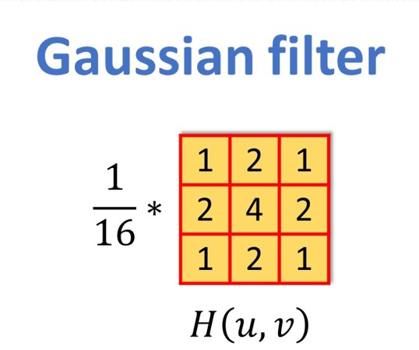
Gaussian filter
Gaussian smoothing operator is used to `blur' images and remove detail and noise

Slide 11
Two main types of filters cont…
sliding median filter is a simple example A non-linear filtering
The median filter is useful in reducing impulsive, or salt-and-pepper noise (black and white dots)

